Slide 1
Investigating the State-of-the-Art of Differential Privacy in Natural Language Processing
03.07.2023, Bachelor Thesis Kick-off Presentation
Natalia Milanova

Slide 2
Outline
Motivation
Research Questions
Methodology and Initial Findings
  Systematic Literature Review
  Semi-structured Interviews
  Next steps
  Timeline

Slide 3
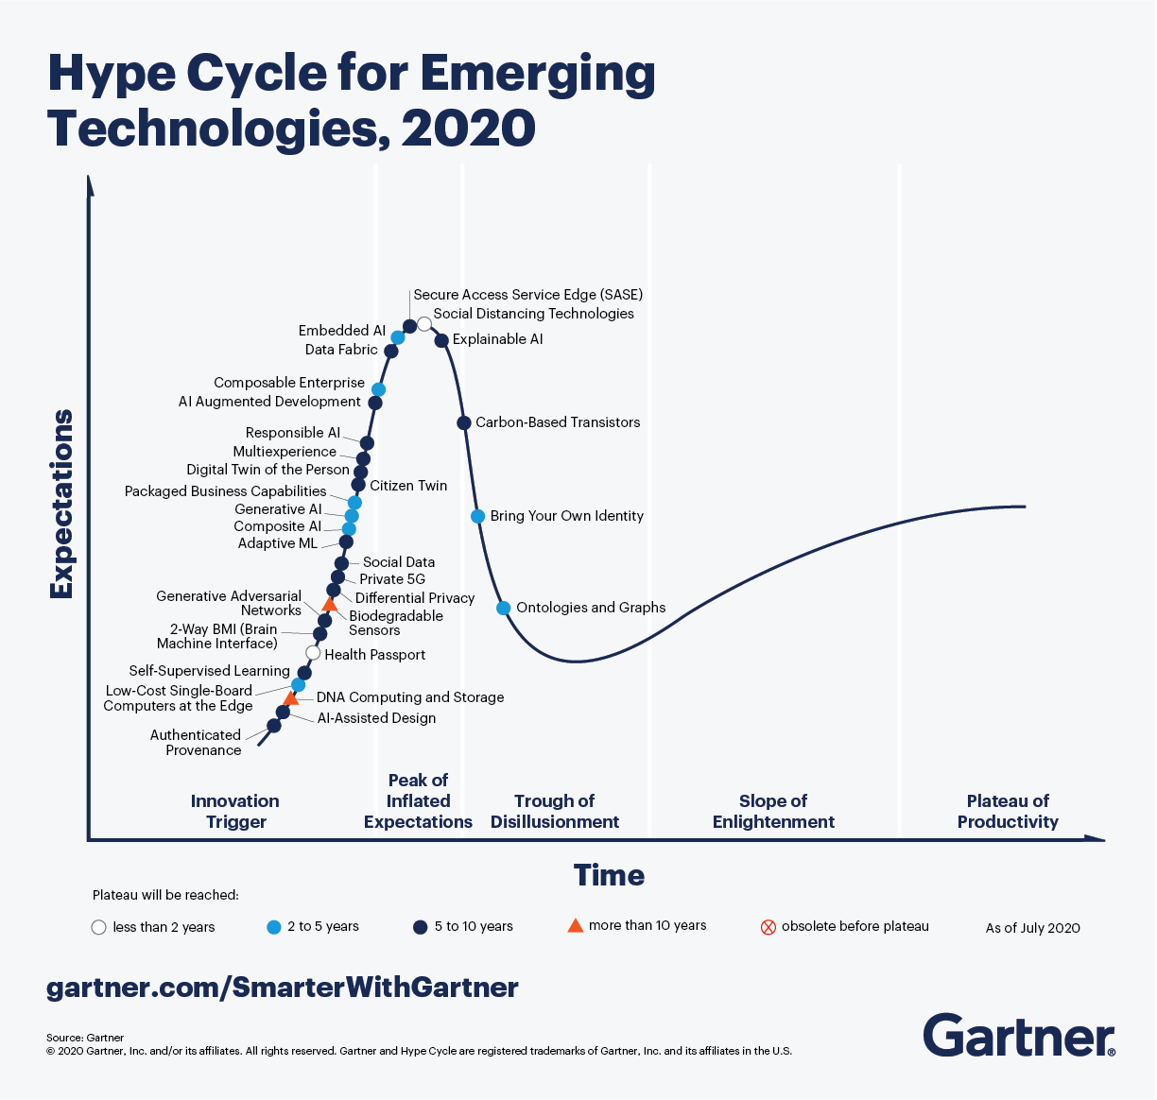

Motivation
Gartner’s Hype Cycle and scientists’ opinion
“Differential privacy has become a de facto standard” [1]
[2]image1

Slide 4
Problem statement
What is covered by academic literature
Founded Research Gap and Aim
Relevant concepts of differential privacy are easily provided through literature and platforms [3]
Focus on differentially private algorithms and diverse differentially private relaxations [4]
Typical mistakes and proposed counterexamples [5]
Focus on recommendations on how to choose the right epsilon value [6]
Limited work regarding practical application of differential privacy in NLP
There do not exist any guidance on choosing differential privacy at all
-> Research gap: what are the requirements to implement differential privacy
-> Aim:
to motivate practitioners to apply differential privacy and to broaden the applicability of differential privacy

Slide 5
Research Questions
Investigating the State-of-the-Art of Differential Privacy in Natural Language Processing
RQ1: What are the properties of Differential Privacy that define its practical application settings?
RQ2: How can these characteristics be mapped appropriately to Natural Language Processing use cases?
RQ3: What are the barriers to adoption for differential privacy in Natural Language Processing, and what success factors have been observed?
Literature Review
Literature Review
Semi-structured interviews

Slide 6
Research Methodology
Literature Review
Semi-structured Interviews
Design Literature Review Strategy
Databases:
  Google Scholar, Scopus, IEEE
Inclusion criteria
Exclusion criteria
~ 90 scientific papers
Search properties of Differential Privacy
Based on the results, determine how this properties can be mapped to NLP use cases appropriately
Foundation for the semi-structured interviews
Design interview based on the findings
Semi-structured Interviews with
Scientists drawn from the papers
Practitioners
Synthesis
Derive Research Results

Slide 7
Research Methodology
Inclusion criteria
Exclusion criteria
Keywords derived from the research questions
  RQ1: What are the properties of Differential Privacy that define its practical application settings?
      differential privacy, properties/characteristics/requirements, practical application
  RQ2: How can these characteristics be mapped appropriately to Natural Language Processing use cases?
      differential privacy, NLP applications/use case, properties/requirements
Backwards snowballing
Papers published before 2006
Keywords not relevant for the research excluded
  Graph
  Image
  Encryption
  Federated learning
Papers not relevant for the research based on the title and abstract excluded

Slide 8
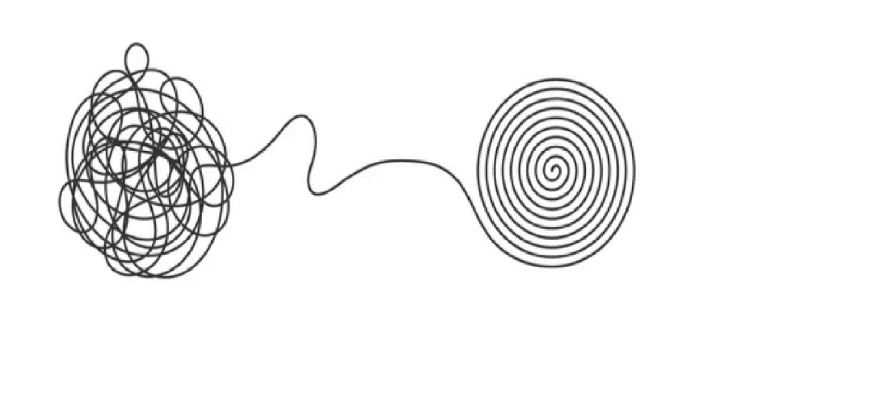


Research Methodology
Define Keywords
Identify relevant scientific literature
Put the found characteristics in order
Inspired by the work of Gallersdorfer and Matthes [10], we split the found characteristics in two categories:
Strict requirements: mandatory characteristics of differential privacy
Lenient requirements: additional characteristics of differential privacy that make the technology more suitable
[7]image2
[8]image3
[9]image4

Slide 9
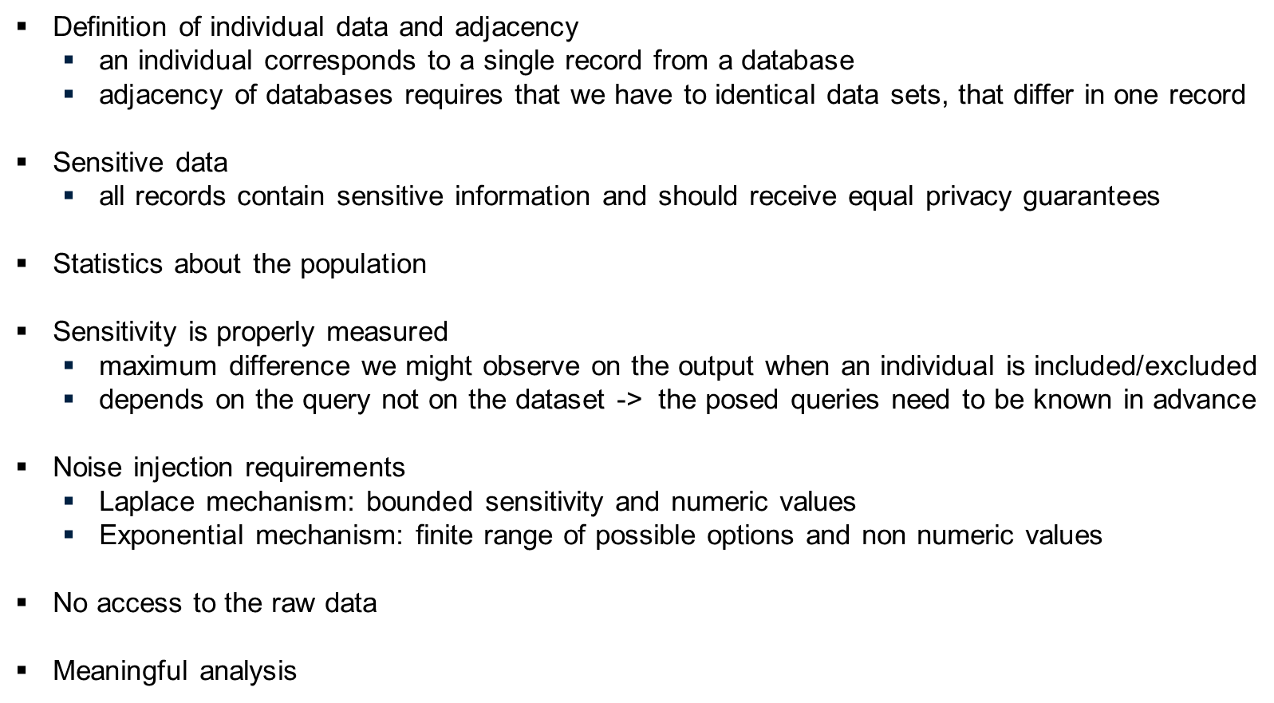
Initial Results
Strict Requirements

Slide 10
Initial Results
Lenient Requirements
Size
  large datasets cancel the added noise according to the Law of Large Numbers
Not suitable for regression
  the injected noise will disrupt the correlation
Not too many records sharing the same sensitive attribute
  the privacy guarantees get worse as long as the size of the group increases

Slide 11






Next Steps
Verify the results and search for current challenges in implementing differential privacy in NLP.
Derive properties from original differential privacy that define its practical application
Map the found properties to NLP settings

Slide 12
Semi-structured Interviews
Goals
Verify RQ1 and RQ2
Answer RQ3
Content of the interviews
Background information
Verify RQ1 and RQ2
Address RQ3
Recommendations for other interview partners
Settings for the interviews
Interviews with scientists drawn from the papers and practitioners
5+ interviews are to be conducted
Via Teams or via Zoom
Recorded interviews (after the data analysis, the recordings will be deleted)

Slide 13
Timeline

Slide 14
References
[1]: Ding, Z., Wang, Y., Wang, G., Zhang, D., & Kifer, D. (2018). Detecting Violations of Differential Privacy. Proceedings of the 2018 ACM SIGSAC Conference on Computer and Communications Security, 475–489. https://doi.org/10.1145/3243734.3243818
[2]: image1: Panetta K.,5 Trends Drive the Gartner Hype Cycle for Emerging Technologies, 2020 https://www.gartner.com/smarterwithgartner/5-trends-drive-the-gartner-hype-cycle-for-emerging-technologies-2020
[3]: Wood, A., M. Altman, A. Bembenek, M. Bun, M. Gaboardi, J. Honaker, K. Nissim, D. O’Brien,
T. Steinke, and S. Vadhan (2018a). “Differential Privacy: A Primer for a Non-Technical
Audience”. en. In: SSRN Electronic Journal. issn: 1556-5068. doi: 10.2139/ssrn.3338027.
url: https://www.ssrn.com/abstract=3338027 (visited on 05/24/2023)
[4]: Desfontaines, D. and B. Pejó (Nov. 2022). SoK: Differential Privacies. arXiv:1906.01337 [cs]. url:
http://arxiv.org/abs/1906.01337 (visited on 05/27/2023)
[5]: Ding, Z., Y. Wang, G. Wang, D. Zhang, and D. Kifer (Oct. 2018). “Detecting Violations of
Differential Privacy”. en. In: Proceedings of the 2018 ACM SIGSAC Conference on Computer and Communications Security. Toronto Canada: ACM, pp. 475–489. isbn: 978-1-4503-5693-0. doi:
10.1145/3243734.3243818. url: https://dl.acm.org/doi/10.1145/3243734.3243818
(visited on 05/24/2023)

Slide 15
References
[6]: Dwork, C., N. Kohli, and D. Mulligan (2019). “Differential privacy in practice: Expose your
epsilons!” In: Journal of Privacy and Confidentiality 9.2
[7]: image2: blossomstar. “Keywording, SEO keywording process, keyword research, keywords optimization flat vector illustration design. Design for web banners and apps”, https://www.shutterstock.com/image-vector/keywording-seo-process-keyword-research-keywords-717141007
[8]: image3: Dan Golden, July 6, 2020, “Keyword Intent: Why It Matters for SEO & How to Do It Right”
[9]: image4: Mironov Konstantin, “Chaos and order business concept flat style design vector illustration isolated on white background. Tangled disorder turns into spiral order line, find solution. Coaching, mentoring or psychotherapy.”
[10]: U. Gallersdörfer and F. Matthes, "Towards Valid Use Cases: Requirements and Supporting Characteristics of Proper Blockchain Applications," 2020 Seventh International Conference on Software Defined Systems (SDS), Paris, France, 2020, pp. 202-207, doi: 10.1109/SDS49854.2020.9143999.

Slide 16
Natalia Milanova
17132
matthes@in.tum.de

